Slide 1
Economics Project – 5 Indian Agriculture: Importance, Development and Challenges
Group - 13

Slide 2
Group Members
Deep Parekh – 1401001
Jeet Parekh – 1401011
Akash Soni – 1401047
Kashish Shah – 1401048
Raj Shah – 1401050
Abhishek Chaudhary-1401059
Deval Shah – 1401060
Maharshi Bhavsar – 1401061
Malav Vora - 1401062

Slide 3
Outline
Agriculture in India
Why is Agriculture essential in India?
Contribution to GDP
Contribution to Employment
Contribution to Exports
Agro Imports of India
Agro Exports of India
Trends of Agro Imports and Exports in INDIA
Importance Of Agriculture In Indian Economy
Indian Agriculture: Development
Economic results of the Green Revolution
Indian Agriculture: Challenges
Solutions to Challenges
Major Steps Taken By Government
Agriculture Consideration in UNION BUDGET 2016
Conclusion

Slide 4
Resources
http://www.ibef.org/download/Agriculture-January-2016.pdf
http://www.economicsdiscussion.net/articles/importance-of-agriculture-in-indian-economy/2088
https://core.ac.uk/download/files/153/6443441.pdf
http://www.ijmra.us/project%20doc/IJPSS_MAY2012/IJMRA-PSS296.pdf
http://ficci.in/spdocument/20550/FICCI-agri-Report%2009-03-2015.pdf
https://en.wikipedia.org/wiki/Green_Revolution_in_India
https://en.wikipedia.org/wiki/Green_Revolution#Green_Revolution.27s_start_in_India
www.airea.net
http://www.indiaonestop.com/Greenrevolution.htm
http://www.fas.usda.gov/data/india-s-agricultural-exports-climb-record-high

Slide 5
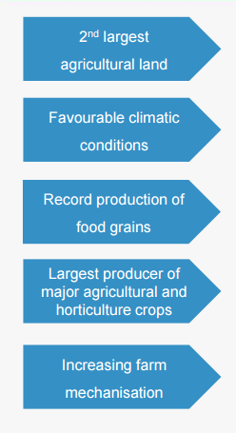
Agriculture in India
At 157.35 million hectares, India holds the second largest agricultural land in the world.
With 20 agro-climatic regions, the country possesses 46 of the 60 soil types in the world.
Total food grains production in India reached an all-time high of 252.68 million tons in FY 2015.
India is the largest producer of spices, pulses, milk, tea, cashew and jute.
India is one of the largest manufacturers of various farm equipments like tractors, harvesters and tillers.
India manufactures one-third of tractors in the world.

Slide 6
Why is Agriculture essential in India?
Agriculture is the backbone of Indian Economy.
About 65% of Indian population depends directly on agriculture and it accounts for around 22% of GDP.
Agriculture derives its importance from the fact that it has vital supply and demand links with the manufacturing sector.
During the past five years agriculture sector has witnessed spectacular advances in the production and productivity of food, grains, oilseeds, commercial crops, fruits, vegetables, food grains, poultry and dairy.
India has emerged as the second largest producer of fruits and vegetables in the world in addition to being the largest overseas exporter of cashews and spices.
Further, India is the highest producer of milk in the world.

Slide 7
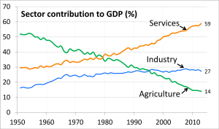
Contribution to GDP

Slide 8
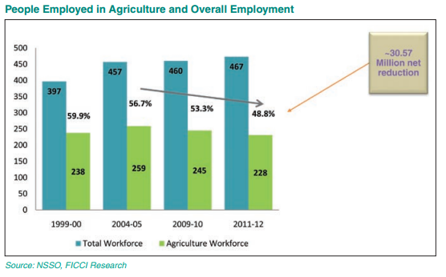
Contribution to Employment
Over years , employment in agriculture has decreased whereas overall employment but overall employment has increased which is due to following reasons:
Advancement in technology
Less labour and more automation
Demand of export quality goods increased

Slide 9
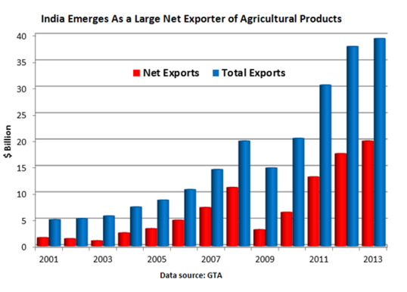
Contribution to Exports
India has emerged as largest net exporter of agro products in the world.
Exports decreased during 2007-2009 period because of global economic crisis .
After that once again exports rose exponentially to 20Bn dollars in 2013.

Slide 10
Agro Imports of India
India imported a total of $1,243 million worth agricultural products in 2005.
In 2011, it increased to $3,592 million.
Product | 2008 | 2009 | 2010 | 2011 | 2012 | 2013 | 2014
Live trees and other plants; | $1,728,531 | $2,723,354 | $5,336,567 | $6,374,277 | $5,486,063 | $4,822,664 | $7,398,673
Edible vegetables and certain roots and tubers | $593,465,042 | $875,069,145 | $1,279,414,055 | $1,464,565,853 | $2,066,781,646 | $1,874,417,081 | $1,864,603,634
Edible fruit and nuts; peel of citrus fruit or melons | $311,059,357 | $376,510,866 | $465,055,752 | $526,648,670 | $560,792,870 | $734,597,912 | $939,066,201
Coffee, tea, matF and spices | $199,947,283 | $174,166,617 | $206,139,815 | $277,371,287 | $275,934,310 | $316,819,582 | $422,754,668
Cereals | $2,729,092 | $312,633,300 | $1,299,863,727 | $274,790,483 | $12,952,373 | $116,312,610 | $12,512,375
Products of the milling industry; malt; starches; inulin | $8,224,517 | $12,486,919 | $17,080,212 | $21,184,621 | $22,259,717 | $28,870,100 | $37,541,055
Oil seeds and oleaginous fruits | $68,837,205 | $83,573,806 | $122,431,634 | $154,850,424 | $172,932,834 | $158,036,882 | $179,388,577
Lac; gums, resins and other vegetable saps and extracts | $54,762,210 | $68,849,766 | $66,205,191 | $84,989,285 | $82,595,793 | $117,469,101 | $119,141,769
Vegetable plaiting materials; vegetable products nes | $2,089,639 | $3,302,212 | $2,736,001 | $4,655,628 | $6,754,744 | $8,879,646 | $9,258,116
Total | $1.2B | $1.9B | $3.2B | $2.8B | $3.2B | $3.3B | $3.5B

Slide 11
Agro Exports of India
India exported a total of $4,508 million worth agricultural products in 2005.In 2011, it increased to $14,221 million.
Product | 2005 | 2006 | 2007 | 2008 | 2009 | 2010 | 2011
Live trees and other plants; | $61,411,583 | $81,497,299 | $120,310,441 | $69,319,923 | $56,284,107 | $55,348,190 | $65,027,817
Edible vegetables and certain roots and tubers | $527,303,462 | $600,338,652 | $624,328,087 | $677,362,545 | $792,525,322 | $954,640,897 | $994,706,757
Edible fruit and nuts; peel of citrus fruit or melons | $245,003,921 | $305,609,822 | $330,340,504 | $446,592,592 | $438,207,396 | $494,319,025 | $499,900,333
Coffee, tea, matF and spices | $897,962,855 | $1,124,388,831 | $1,386,094,577 | $1,745,567,030 | $1,518,019,938 | $2,002,744,611 | $2,970,476,213
Cereals | $1,915,272,213 | $1,588,583,488 | $2,770,923,489 | $3,912,218,627 | $2,986,630,246 | $2,923,680,792 | $5,371,012,959
Products of the milling industry; malt; starches; inulin | $32,780,048 | $31,955,659 | $51,831,012 | $60,965,762 | $55,756,232 | $76,295,972 | $135,405,137
Oil seeds and oleaginous fruits | $405,986,513 | $481,706,126 | $759,373,884 | $982,521,886 | $693,744,248 | $1,084,363,438 | $1,853,441,277
Lac; gums, resins and other vegetable saps and extracts | $401,919,953 | $401,044,667 | $387,807,026 | $481,980,236 | $360,723,174 | $657,568,392 | $2,270,833,416
Vegetable plaiting materials; vegetable products nes | $20,787,881 | $20,691,862 | $28,167,804 | $35,530,699 | $34,735,665 | $66,610,778 | $60,689,954
Total | $4.5B | $4.6B | $6.4B | $8.4B | $6.9B | $8.3B | $14.2B

Slide 12
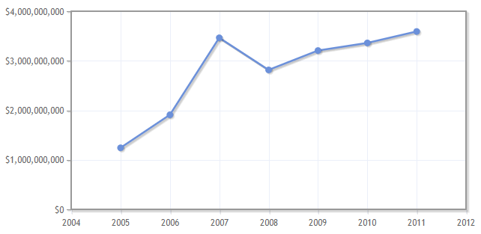
Trend of import of agro products of India
IMPORT
India imported a total of $1,243 million worth agricultural products in 2005.
In 2011, it increased to $3,592 million.
Edible vegetables and certain roots and tubers are highest imported agro goods in India throughout 2004-2012 followed by Edible fruit and nuts; peel of citrus fruit or melons
Amount In $
Year

Slide 13
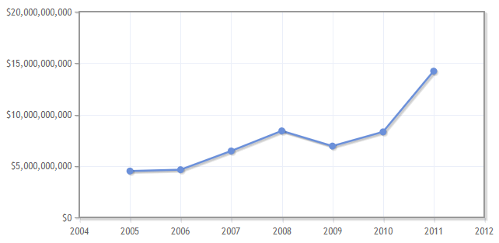
Trend of Export of agro products of India
India exported a total of $4,508 million worth agricultural products in 2005.
In 2011, it increased to $14,221 million.
Cereals account for highest exported agro product of India followed by Coffee, tea and spices.
Amount In $
Year

Slide 14
Importance Of Agriculture In Indian Economy
Though industry has been playing an important role in Indian economy, still the contribution of agriculture in the development of Indian economy cannot be denied.
Influence on GDP:
The contribution of agriculture in Indian GDP was 48-60% during the first two decades of independence, but this contribution has declined to about 26% in the last decade.
Generating Employment:
Employment in the agriculture Sector as Share of Total Employment in last decade was 52.1%, making it single largest private sector occupation. In 1951, India’s 70% population was engaged in agriculture.
We can say that in last 6 decades a substantial part of our population has been dependent upon agriculture.

Slide 15
3. Provision for food for increasing population:
Due to the excessive pressure of population labor surplus economies like India and rapid increase in the demand for food, food production increases at a fast rate.
The existing levels of food consumption in these countries are very low and with a little increase in the capita income, the demand for food rise steeply (in other words it can be stated that the income elasticity of demand for food is very high in developing countries).
Therefore, unless agriculture is able to continuously increase it marketed surplus of food grains, a crisis is like to emerge. Many developing countries are passing through this phase and in a bid to ma the increasing food requirements agriculture has been developed.

Slide 16
4. Contribution to capital formation:
Since agriculture happens be the largest industry in developing country like India, it can and must play an important role in pushing up the rate of capital formation.
If it fails to do so, the whole process economic development will suffer a setback.
5. Supply of raw material to agro-based industries:
Agriculture supplies raw materials to various agro-based industries like sugar, jute, cotton textile and Vanaspati industries.
Food processing industries are similarly dependent on agriculture.
Therefore the development of these industries entirely is dependent on agriculture.
6. Market for industrial products:
Increase in rural purchasing power is very necessary for industrial development as two- thirds of Indian population live in villages.
After green revolution the purchasing power of the large farmers increased due to their enhanced income and negligible tax burden.

Slide 17
7. Influence on internal and external trade and commerce:
Indian agriculture plays a vital role in internal and external trade of the country. Internal trade in food-grains and other agricultural products helps in the expansion of service sector.
8. Contribution in government budget:
Right from the First Five Year Plan agriculture is considered as the prime revenue collecting sector for the both central and state budgets.
However, the government earns huge revenue from agriculture and its allied activities like cattle rearing, animal husbandry, poultry farming, fishing etc.
9. Need of labor force:
A large number of skilled and unskilled laborers are required for the construction works and in other fields.
This labor is supplied by Indian agriculture.
10. Greater competitive advantages:
Indian agriculture has a cost advantage in several agricultural commodities in the export sector because of low labor costs and self- sufficiency in input supply.

Slide 18
Indian Agriculture: Development
When India became independent in 1947, the agricultural productivity was very low (about 50 million tons). The agriculture was mainly rained and was being done as a subsistence farming using mainly animate sources of farm power and traditional tools and equipment’s.
More than 80% of the population living in rural areas was dependent on agriculture for their livelihood.
Before mid-1960, India relied on imports and food aid to meet domestic requirements.
The two-year drought of 1965 and 1966 made the government then reform the agricultural policy of India.

Slide 19
1. Agricultural Education:
Efforts were then concentrated mainly to develop labour saving manual and animal drawn implements.
Later, with the starting of B.Sc. Agricultural Engineering Programme at Allahabad Agricultural Institute during 1942, establishment of Agricultural Engineering Division at TART in 1947, Agricultural Engineering Department at IIT, Kharagpur in 1954, and colleges of Agricultural Engineering and Technology at Pantnagar, Ludhiana, Jabalpur, Udaipur, Coimbatore.
1960s gave an impetus to agricultural engineering research programmes.
2. New Organizations:
More recently, organizations other than the ICAR have shown interest in sponsoring research in different areas of agricultural engineering, either by giving financial support or as integral part of the activity of these organizations.
Some of these organizations are Ministry of Non-conventional Energy Sources, Department of Electronics, Department of Science and Technology, Department of Agriculture and Co-operation,Tata Energy Research Institute and the Indian National Committee of Irrigation and Drainage etc.

Slide 20
3. Projects:
Besides these research-cum-academic institutions, a good amount of research opportunity was opened up in the soil and water engineering with the establishment of the 1st river valley project, the Damodar Valley Corporation in 1949, to tackle the problems of soil and water conservation in Bihar and West Bengal.
This was followed by the Government of India’s initiative in establishing soil conservation centres at different regions of the country from the First Five-Year plan.
Subsequently all these centres were administratively combined together as a Central Soil and Water Conservation Research Institute at Dehra Dun under the ICAR in 1975, with 6 regional centres.
They also started another project on Evaluation of Power Tillers for Indian conditions. These projects yielded good results and many types of equipment were developed.

Slide 21
4. Green Revolution: Green Revolution in India was a period when agriculture in India increased its yields due to improved agronomic technology. It allowed agriculture in India, to overcome chronic food defects. It started in the early 1960s and led to an increase in food production.
The well irrigated and permanently irrigated area was only 17% in 1951. The majority of the area was dependent on rainfall and, consequently, agriculture suffered from low level of production.
The green revolution was possible due to adequate water supply through irrigation.
The government undertook a number of minor, major and multipurpose irrigation projects to supply sufficient water to cultivable lands so that the dependence of farmers on rainfall reduced to great extents.
Rice yield in 1960s was two tons per hectare. In 1990s, it increased to six tons per hectare.
In 1948, Indian wheat farm produced an average of 0.8 tons of wheat per hectare. In 1975, that increased to 4.7 tons per hectare. And in 2000, it reached 6 tons per hectare.

Slide 22
Economic results of the Green Revolution
Growth of the local manufacturing sector of fertilizer, insecticides, pesticides, fungicides, and other chemicals. Such industrial growth created new jobs and contributed to the country's GDP.
The increase in irrigation created need for new dams to harness monsoon water. The water stored was used to create hydro-electric power.
India paid back all loans it had taken from the World Bank and its affiliates for the purpose of the Green Revolution. This improved India's creditworthiness in the eyes of the lending agencies.
Some developed countries, especially Canada, which were facing a shortage in agricultural labor, were so impressed by the results of India's Green Revolution that they asked the Indian government to supply them with farmers experienced in the methods of the Green Revolution.

Slide 23
Indian Agriculture: Challenges
In the new millennium, the challenges in Indian agricultural sector are quite different from those met in the previous decades.
To keep up the momentum of growth a careful economic evaluation of inputs like seeds, fertilizers, irrigation sources etc are of considerable importance.
Some of the challenges faced by India are as follows:
High Productivity at reduced cost:
Considering the irrigation needs in Indian agriculture, emphasis be given to promote the proven cost-reducing micro-irrigation technology of drips irrigation which helps conserve water reduces fertilizer inputs and ensures higher productivity.
Farmer awareness programmes coupled with subsidy incentive may prove helpful strategies.
The sustainable method of irrigation needs to be popularized. Salinity and water logging problems in the commands of major irrigation systems need to be minimized by recognizing and incorporating corrective measures.

Slide 24
2. Fertilizers:
Diffusion of fertilizer consumption in Indian agriculture has been quite widespread. The imbalances in the use of N, P and K have become highly conspicuous.
The intensity of fertilizer use has gradually gone up from about 3 kg/ha in early sixties to about 88 kg/ha in 1997-98.
Therefore, wider distribution of fertilizer needs to be promoted by covering regions with low use of fertilizers through creation of an extensive network of rural infrastructure (including roads and credit) for establishing an appropriate interface of input markets and output markets in these regions.
3. Good quality seeds:
In Indian agriculture, multiplication, distribution and availability of good quality seed is crucial to accelerated food production.
With entry of MNCs in seed production and distribution and consequent effects of patenting under the WTO regime, providing quality seeds to farmer at an affordable cost will be a measure challenge in future.
To meet the growing competition companies should adopt modern processing technologies and seed growers have to be trained in cost reducing methods of growing quality seed material.

Slide 25
4. Develop agro based industries:
The farm credit system in Indian agriculture, evolved over decades has been instrumental in enhancing production and marketing of farm produce and stimulating capital formation in agriculture.
Credit for Indian agriculture has to expand at a faster rate than before because of the need to step-up agricultural growth to generate surplus for exports, and also because of change in the product mix towards animal husbandry, aquaculture, fish farming, horticulture and floriculture, medicinal plants, which will necessitate larger investments.
5. Women farmers:
In Indian agriculture, rural women play a vital role and participate in all stages of crop production, as they constitute 50% of rural labour force.
They contribute in agricultural operations like, transplanting, manuring and fertilizing, harvesting, threshing, winnowing, drying and carrying the product.
To better exploit the emerging opportunities, there is need for changing property rights in favour of women, evolving technologies to suit women farmers, increasing the number of women extension workers, educating and training women farmers.

Slide 26
6. Fragmented Land Holdings:
Nearly 80% of the 140 million farming families hold less than 2 acres of land.
Large land holdings enable the farmer to implement modern agricultural techniques and boost productivity.
Small land holdings restrict the farmer to use traditional methods of farming and limit productivity.
7. Overdependence on traditional crops:
Every crop requires certain climatic conditions to give the best yields.
Though rice and wheat are produced in a large area in India, certain areas can readily switch to other crops to get better productivity. India is importing cooking oil from abroad though we have the necessary conditions to grow more oilseeds here.
Heavy dependence on traditional rice and wheat points to the lack of a proper national plan on agriculture.
Excess stocks in a few crops lead to problems in the selling of the produce, storage and shortage of other essential farm output.
Moreover, if the farm output is skewed towards crops like rice, irrigation and ground water facilities are misused by farmers, which leads to a host of other problems.

Slide 27
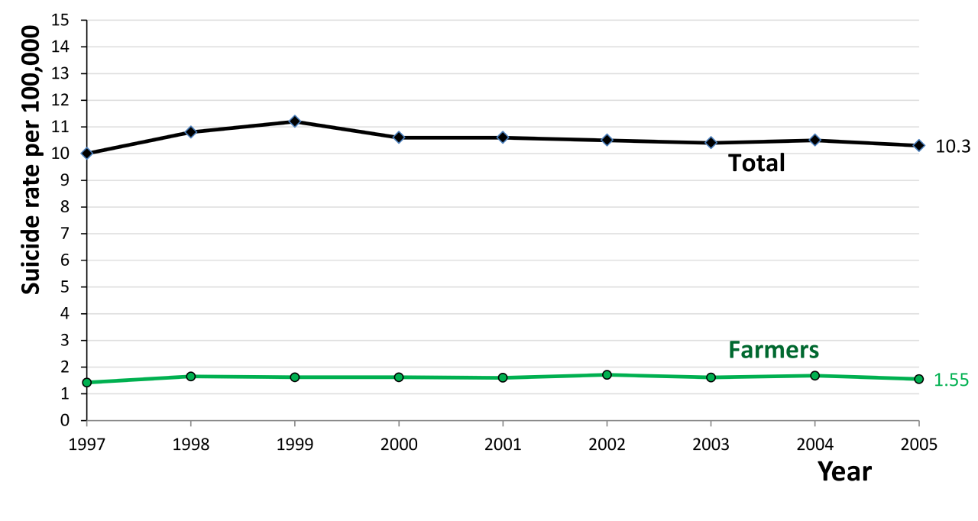
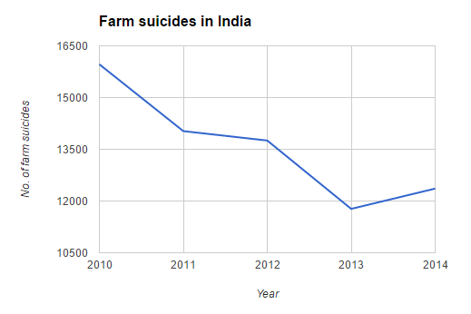
8. Farmer Suicides:
Farmer suicides account for 11.2% of all suicides in India and hence it is one of the most important challenge for Indian agricultural sector.
In 2013, but in general there is a slow decline in the number of officially recorded farm suicides.
In 2014, India recorded 12,360 farm suicides. This is slightly more than the number of farmer suicides registered

Slide 28
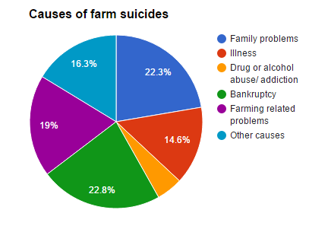
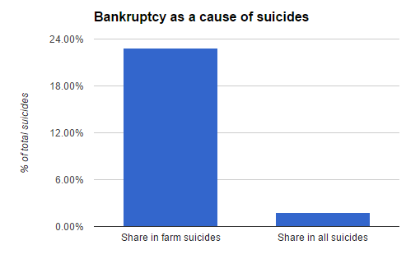
Activists and scholars have offered a number of conflicting reasons for farmer suicides, such as
monsoon failure,
high debt burdens,
genetically modified crops, government policies,
public mental health, personal issues and family problems.
But about 42% of the farmers suicide has been because of bankruptcy or farming relating problems.
Bankruptcy contributes significantly more to farm suicides than to other suicides.

Slide 29
Solutions to Challenges
Consolidation of village lands and cooperative farming will ease the burden of fragmented land holdings.
When the farmers form an association at the village level, the aggregate land can be farmed by using the latest technology.
Banks too will be willing to lend money to a village consortium which can be utilized to boost farm productivity, employ sustainable farming methods, reduce over – dependence on fertilizers and thus solve many problems.
Irrigation problems can be addressed by Government – preferably at the State and National levels.
Though the Government cannot force farmers to produce only the designated crops in particular areas, it can surely educate them about the alternatives.
When proper techniques (in water management as well as a crop plan of what to produce and where to produce) are employed, it will be a win – win situation for both the farmers as well as the country.

Slide 30
Irrigation problems as well as problems due to single/traditional crop dependence can be solved by a national level plan for agricultural production. Government can encourage farmers to shift to cash crops (oil seeds etc) instead of food crops in areas where food crops are not at an advantage to reduce imports and also to boost exports.
Scientific research in this subject is to be encouraged to promote seeds which are mild on resource requirements but help the farmers in boosting the yields.
Some sustainability solutions are proper crop management on the basis of water availability, crop rotation, deploying modern agricultural practices to boost productivity, switching over to organic farming (village pools will reduce costs), thrust on allied activities.
Seed problems can be overcome by creating in house seed banks at the village level for traditional crops (thereby reducing farmer dependence on external seed banks), selling Government approved seeds through proper channels and strict penalties on seed marketing companies in case the seeds do not match the claims – germination and yield - of the companies.
Terminator seeds should not be encouraged as a matter of principle as they force farmers to buy seeds for every crop.

Slide 31
Major Steps Taken By Government
Major steps take to address the two major factors critical to agricultural production, that of soil and water.
* 'Paramparagat Krishi Vikas Yojana' to be fully supported.
* 'Pradhanmantri Gram Sinchai Yojana' to provide 'Per Drop More Crop'.
* Rs 5,300 crore to support micro-irrigation, watershed development and the 'Pradhan Mantri Krishi Sinchai Yojana'. States urged to chip in.
* Rs 25,000 crore in 2015-16 to the corpus of Rural Infrastructure Development Fund (RIDF) set up in NABARD; Rs 15,000 crore for Long Term Rural Credit Fund; Rs 45,000 crore for Short Term Co-operative Rural Credit Refinance Fund; and Rs 15,000 crore for Short Term RRB Refinance Fund.
* Target of Rs 8.5 lakh crore of agricultural credit during the year 2015-16.
* Focus on improving the quality and effectiveness of activities under MGNREGA.

Slide 32
Major reforms in Indian agriculture
The Indian agricultural services and agricultural machinery have cumulatively attracted USD2,211.17 million from April 2000 to September 2015
Paramparagat Krishi Vikas Yojana (PKVY): This scheme ensures the promotion of organic farming. Rs 300 crore has been allocated for the scheme during the year 2015-16.
Incentivizing agricultural research: Realizing that scientific and technical breakthroughs are critical to increasing agricultural productivity, the government, in its FY16 budget, allocated USD612.31 million to incentivize farm research
Budget 2015 – 16 aims at expanding R&D in the agricultural sector to improve its productivity by enhancing crop yields.
Regional Rural Bank Credit Refinance Fund: In budget for FY16, the government raised the target for agricultural credit from USD26.04 billion to USD132 billion.
Fund Allocated: Allocation of USD4.14 billion to the corpus of Rural Infrastructure Development Fund(RIDF) in 2015 – 16.

Slide 33
Agriculture Consideration in UNION BUDGET 2016
The Union Budget for 2016 takes cognizance of these concerns - of increasing agricultural productivity and bettering the lives of poor farmers with a lasting goal of retaining the farmer in farming. Three important budgetary provisions towards achieving this will positively impact agriculture:
Financial support to extend irrigation and soil health for enhancing agricultural productivity.
Raising the agricultural credit, and
Creation of a unified national agricultural market to fetch a fair price for the farm produce.
The Budget shows intent to support organic farming and continued support for micro irrigation and watershed management.
These are expected to ameliorate the lives of farm families and check on urban migration in search of livelihood.
For those of us in the seeds sector, which is key to increasing agriculture productivity, extension of irrigation and improved soil health will pave the way for greater demand for quality seeds of high-yielding hybrids and varieties of three major food basket crops - rice, wheat and maize.

Slide 34
Technological Growth of Agriculture In INDIA
Sikkim is the first Indian state that is fully organic and has implemented organic practices on around 75,000 hectares of agricultural land. The Sikkim government led by Chief Minister Pawan Chamling has made it possible with a critically low technology available for farms and agriculture sector.
Currently, input of technology in Indian agriculture sector is critically low. Instances of low crop production are severely high. There is a dire need to turn farming profitable by rendering cheap and advanced farming methods to one and all.
But also on the brighter side, there are many instances out there where young as well as experienced minds of country have found solace and are revolutionizing agriculture sector through their startups.
In forthcoming slides, we bring you list of such few startups which are enabling advanced agriculture practice in the country.

Slide 35

Agriculture Startups
M.I.T.R.A. (Machines Information Technology Resources Agriculture) is a Hindi word which means friends.
M.I.T.R.A. was founded by Devneet Bajaj, a strategy, finance and business development expert. The company develops proprietary agricultural machines that automate labor-intensive functions for farmers.
The company produces and markets fully automated vineyard/orchard sprayers for different crops and dry chemical dispensing units.
The mission of the company is to build exciting new products for Indian farms and export markets with a vision to be a global player in R&D and manufacturing of high quality farm equipment.

Slide 36

Stellapps
When Ranjith Mukundan quit his job at Wipro in 2011 after 15 years, farming wasn't on his mind. Bengaluru-born Mukundan and his four co-founders were exploring the Internet of Things space, the idea of connecting ordinary objects to send and receive data.
They considered telemedicine, but decided against it since many MNCs were in the business.
That's when one of the founders pointed to the problems in dairy management, including that milk stored in regular containers become non-consumable after a few hours. His uncle was an organic dairy farmer in Tiptur, a town 150km north west of Bengaluru, and had trouble managing his cattle and the supply chain.
They liked the idea so Mukundan, now 41, and the team spent the next eight months at the dairy farm and also visited farms in Uttar Pradesh, Madhya Pradesh, Punjab and Odisha.
Their company, Stellapps, used their learnings to develop automated dairy solutions, and now works with milk cooperative societies such as Aavin, Milma and Tirumala. Its products are in 250 farms and are used by three lakh dairy farmers.

Slide 37
Conclusion
India is an agricultural country but it still needs to improve in this sector because of the problems we are currently facing and to avoid the problems we might face in future.
Also, keeping in mind the increasing population of the country and its agricultural needs, various steps need to be taken such that the future growth of agriculture is yield based.
Suicide is one the key problems government needs to work on and reduce the rate of suicide in coming years.
Development of infrastructure is also important to fulfill the required growth.
Agriculture Startup has revolutionized the agriculture producing capacity and quality of agro products to a significant extent
The public-private partnership model could be just the game-changer India’s agricultural sector needs. By drawing on the collective power of all agricultural stakeholders, PPPs can transform the sector at multiple levels.

Slide 38

END

